Slide 1
Hypothesis Testing

Slide 2
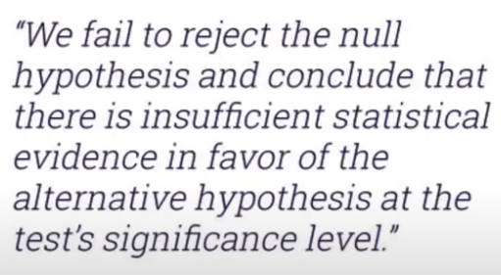



Example
If we did not see any evidence, we go for
default hypothesis, and fail to reject H0
Is there an alien life on the planet Venus?
$H_{0}$: There is no alien life on this planet
$H_{a}$: There is alien life on this planet
What have you learned?
Testing: Does the evidence we collected make H0 look ridiculous?
What have you learned?
Nothing
We have enough evidence to reject H0

Slide 3

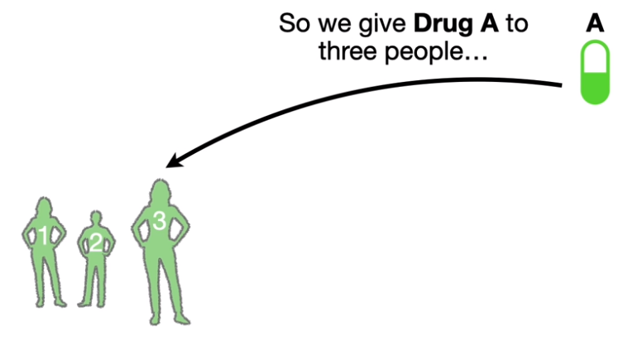
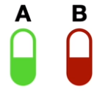
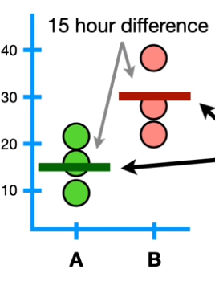
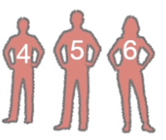
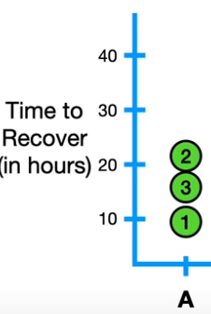

Hypothesis Testing
Not everyone recover in
The same amount of time
People taking Drug A need on average, 15 fewer hours to recover than people taking drug B

Slide 4
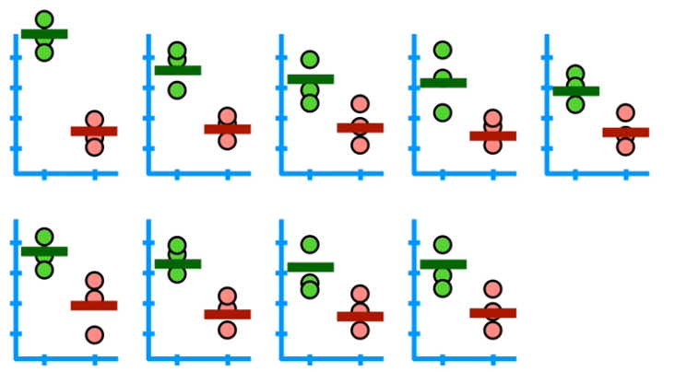
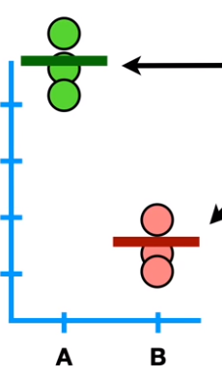
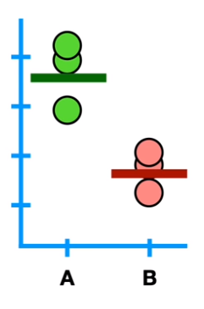
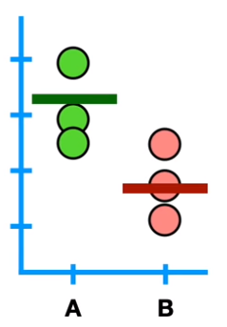
Hypothesis Testing
35 hour difference
People taking Drug A need on average, 15 fewer hours to recover than people taking drug B
We can confidently reject this hypothesis that we came up with after doing preliminary experiments

Slide 5
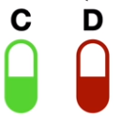
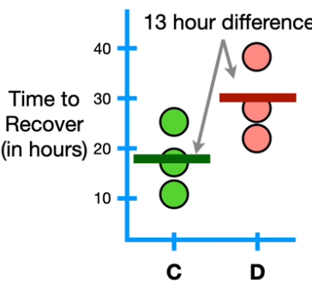
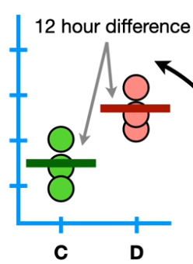
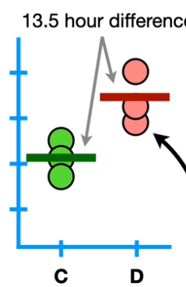
Hypothesis Testing
Fail to reject the hypothesis
The other experiments are not different enough to give us confidence to reject the hypothesis, also they don’t convince us the hypothesis is correct
People taking Drug C need on average, 13 fewer hours to recover than people taking drug D
The only reason the hypothesis is 13 hours is because that was the result from the first experiments

Slide 6
Hypothesis Testing
The goal is to test if there is no difference between the drugs
Hypothesis: There is no difference in recovery times between Drug C and drug D
The hypothesis that there is no difference/signal between things is called Null Hypothesis
We design a significance test to evaluate the strength of the evidence against some null hypothesis (H0​)
The alternative hypothesis (Ha​) is the claim we are trying to find evidence in favor of.

Slide 7
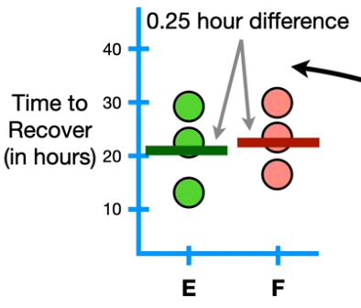
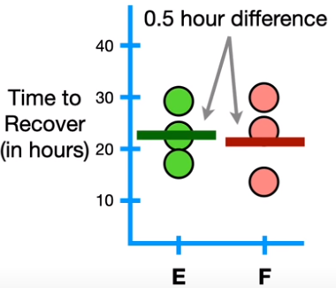
Hypothesis Testing
E F
Null Hypothesis: There is no difference in recovery times between drug E and drug F
The data does not overwhelmingly convince us to reject the Null Hypothesis
We fail to reject the Null Hypothesis that there is no difference between drugs

Slide 8
Null Hypotheses
Without the Null Hypothesis, we need preliminary data to make a hypothesis to test with follow up experiments
The Null Hypothesis does not require preliminary data because the only value that represents no difference is 0
The game of Hypothesis Testing is all about determining whether the evidence we have makes our null hypothesis look ridiculous

Slide 9
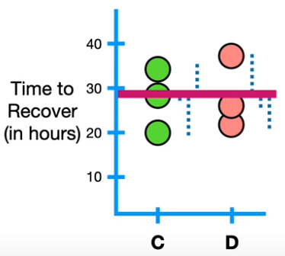
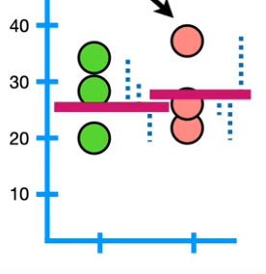
Alternative Hypothesis
Most of the time, when we have two dataset, alternative hypothesis is the opposite of the null hypothesis
Null Hypothesis: There is no difference in recovery times between drug C and D
Alternative Hypothesis: There is a difference in recovery times between drug C and D
If there is no dramatic difference between these distances from the mean, we fail to reject the null hypothesis

Slide 10

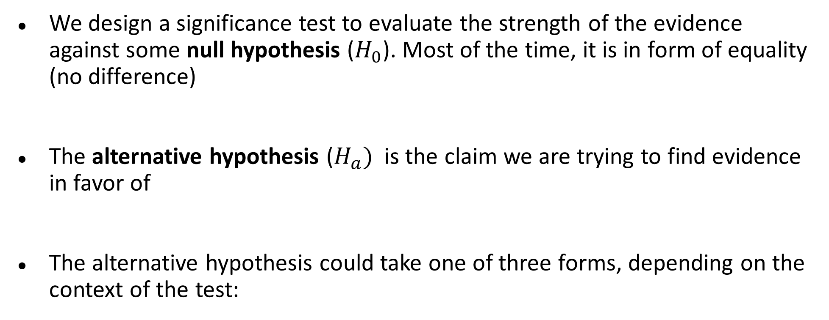
Alternative Hypothesis
We design a significance test to evaluate the strength of the evidence against some null hypothesis ($H_{0}$​). Most of the time, it is in form of equality (no difference)
The alternative hypothesis ($H_{a})$ is the claim we are trying to find evidence in favor of
The alternative hypothesis could take one of three forms, depending on the context of the test:

Slide 11
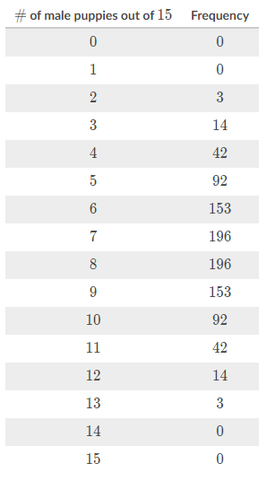
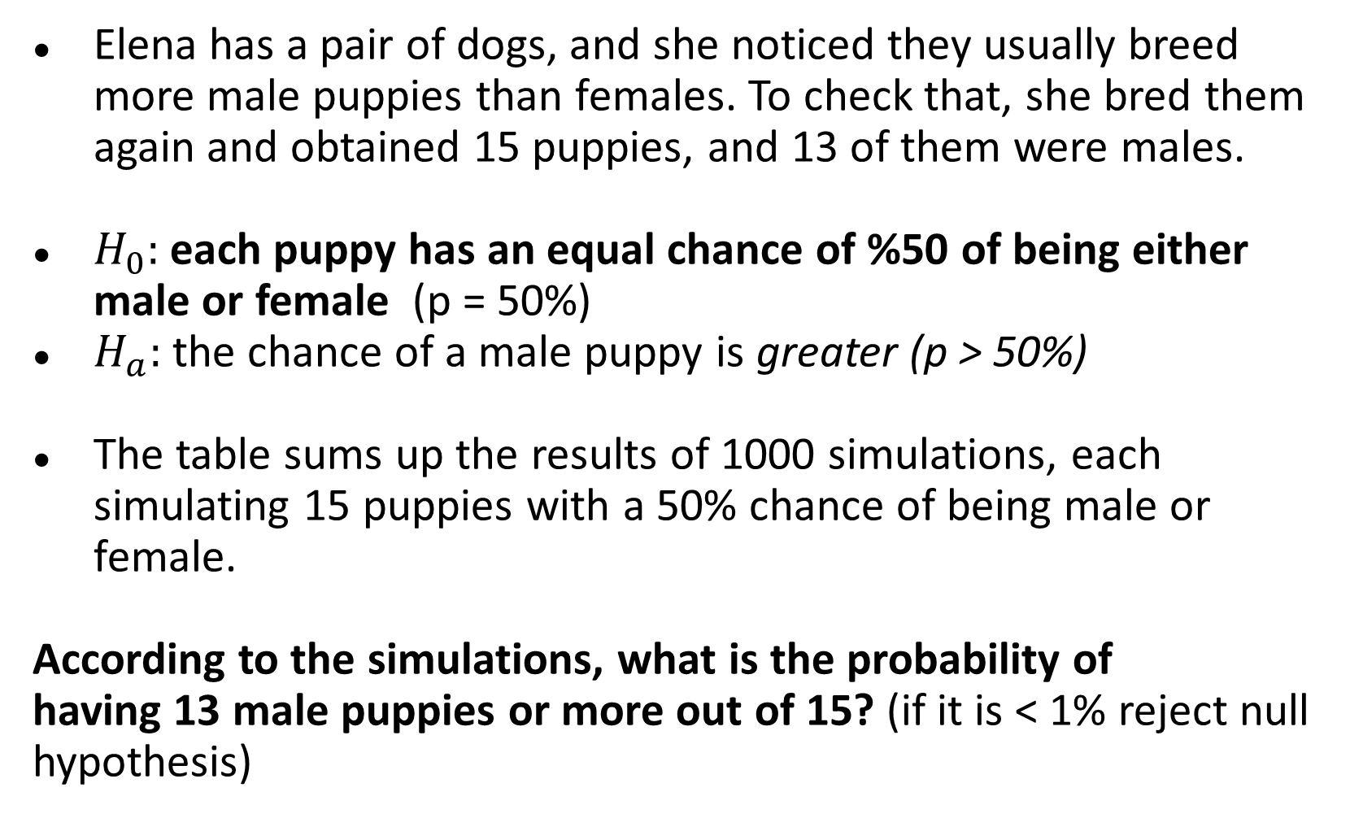
Example
Elena has a pair of dogs, and she noticed they usually breed more male puppies than females. To check that, she bred them again and obtained 15 puppies, and 13 of them were males.
$H_{0}:$each puppy has an equal chance of %50 of being either male or female (p = 50%)
$H_{a}:$the chance of a male puppy is greater (p > 50%)
The table sums up the results of 1000 simulations, each simulating 15 puppies with a 50% chance of being male or female.
According to the simulations, what is the probability of having 13 male puppies or more out of 15? (if it is < 1% reject null hypothesis)
3/1000 = 0.3% = 0.003

Slide 12
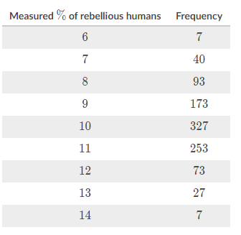
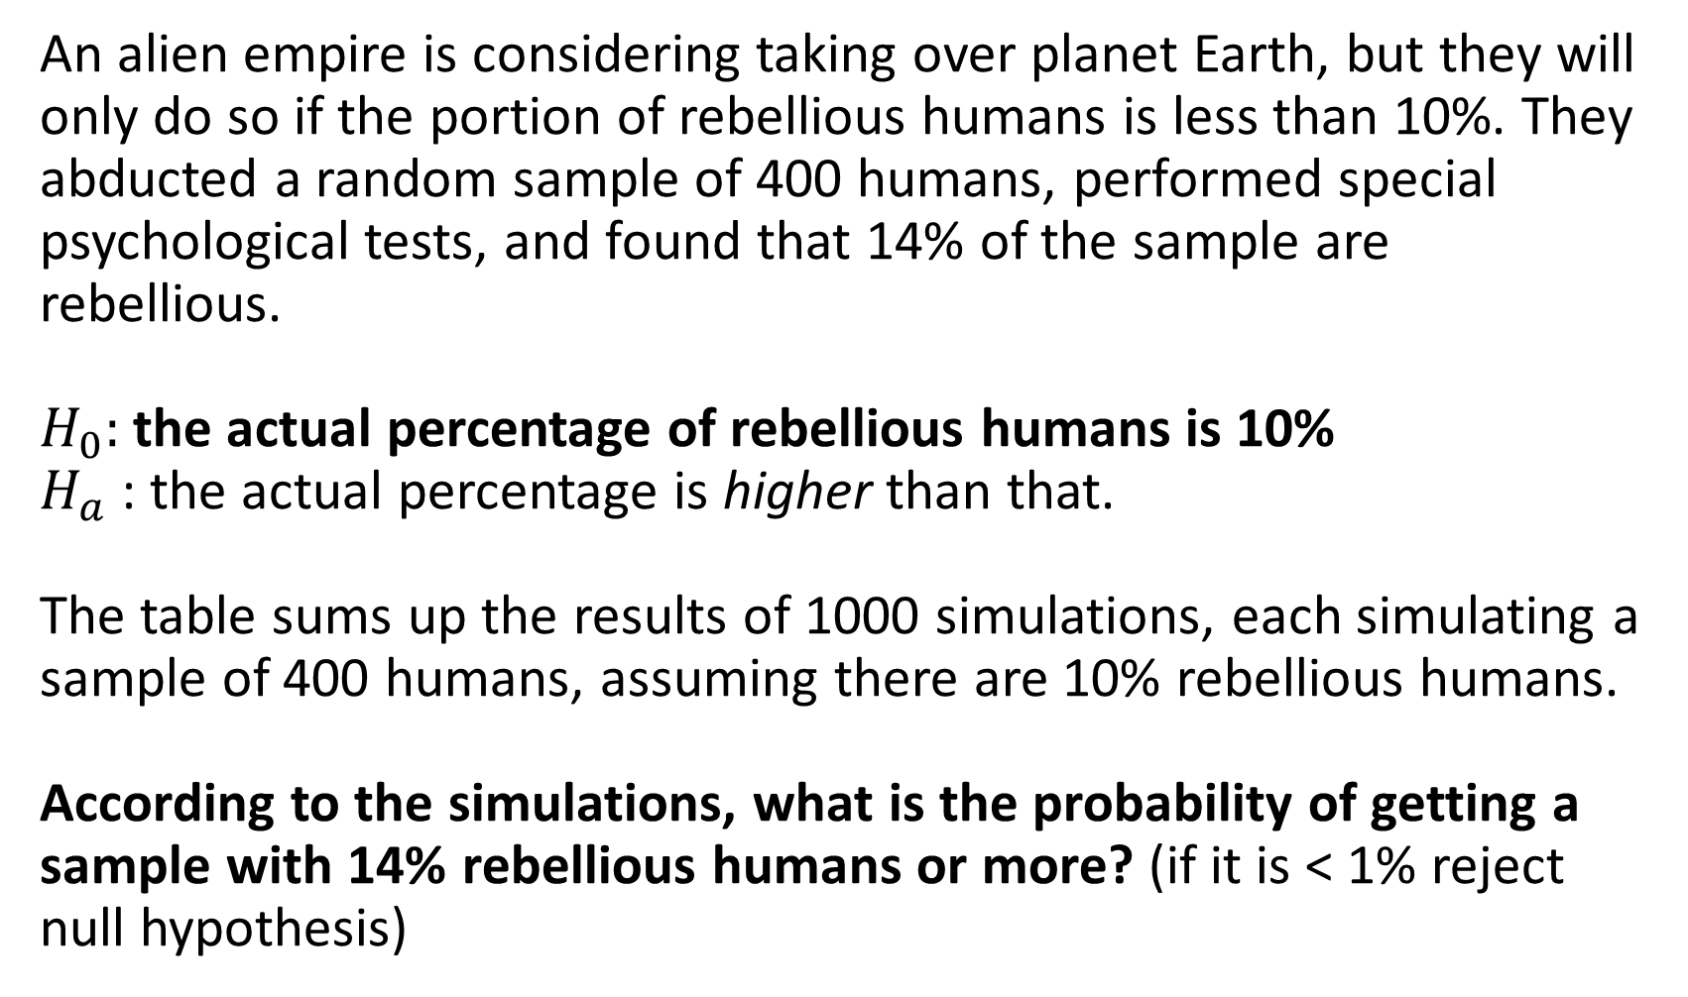
Example
An alien empire is considering taking over planet Earth, but they will only do so if the portion of rebellious humans is less than 10%. They abducted a random sample of 400 humans, performed special psychological tests, and found that 14% of the sample are rebellious.
$H_{0}:$the actual percentage of rebellious humans is 10%
$H_{a}$: the actual percentage is higher than that.
The table sums up the results of 1000 simulations, each simulating a sample of 400 humans, assuming there are 10% rebellious humans.
According to the simulations, what is the probability of getting a sample with 14% rebellious humans or more? (if it is < 1% reject null hypothesis)
7/1000 = 0.7% = 0.007

Slide 13
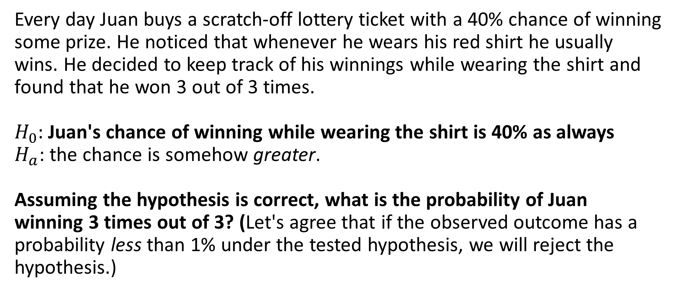
Example
Every day Juan buys a scratch-off lottery ticket with a 40% chance of winning some prize. He noticed that whenever he wears his red shirt he usually wins. He decided to keep track of his winnings while wearing the shirt and found that he won 3 out of 3 times.
$H_{0}:$Juan's chance of winning while wearing the shirt is 40% as always
$H_{a}$: the chance is somehow greater.
Assuming the hypothesis is correct, what is the probability of Juan winning 3 times out of 3? (Let's agree that if the observed outcome has a probability less than 1% under the tested hypothesis, we will reject the hypothesis.)
0.4 * 0.4 * 0.4 = 0.064 = 6.4%
6.4% is not less than 1% -> we can not reject the null hypothesis

Slide 14
Kahoot time

